Slide 1
JUNE 06TH 2023
GUYANA SHORE BASE INC.
www.gysbi.com

Slide 2
Base Map
Slide 2- port facility
Slide 3- gysbi industrial estate
Services Required
Snake control
Flies/Mosquitoes spraying
Rodent control
Bee/Wasp removal -24/7hrs service.
Key -Color Representing Services on the map
Snake Control
Flies/Mosquitoes Spraying
Rodent Control
Bees/Wasp Removal – 24/7 Service.

Slide 3
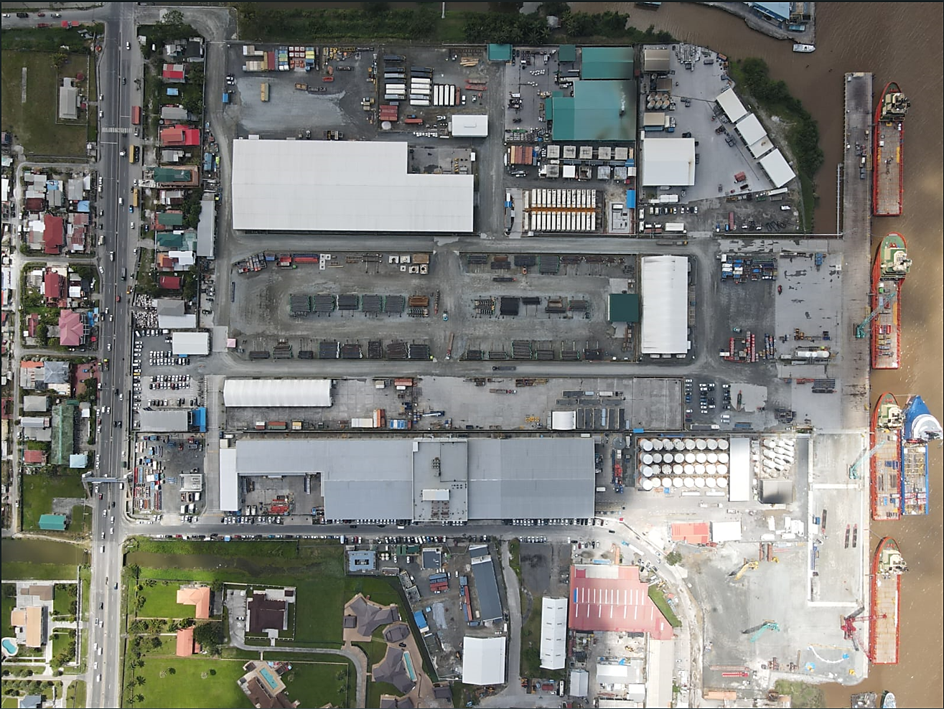
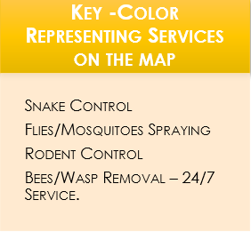
Maintenance Workshop
SBM- W/house
Fuel Farm and Water Bunkering
Procurement
W/House
and Workshop
Exxon Drilling W/House
Lower Pipe Yard
Upper Pipe Yard
Man Camp
Trailer Offices
Main Building
Interim Yard
Container Yard Yard
Wharf Rest Containers
Training Centre

Slide 4
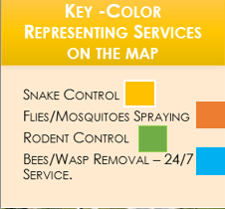
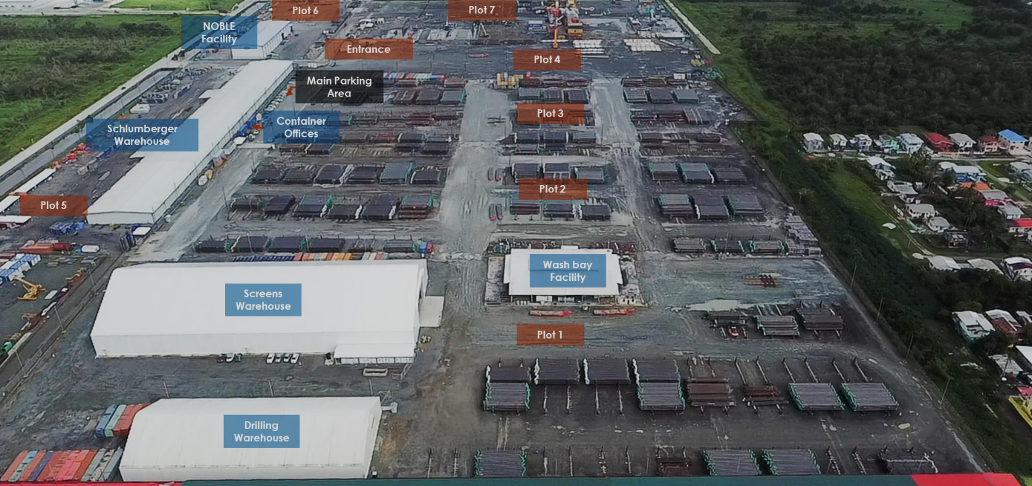
Colors around the perimeter of the base represents the area that needs the services

